Slide 1
Module 20: Introduction to the ASA
Instructor Materials
Networking Security v1.0
(NETSEC)
Notes:
Networking Security (NETSEC) Module 20: Introduction to the ASA

Slide 2
Instructor Materials – Module 20 Planning Guide
This PowerPoint deck is divided in two parts:
Instructor Planning Guide
Information to help you become familiar with the module
Teaching aids
Instructor Class Presentation
Optional slides that you can use in the classroom
Begins on slide # 8
Note: Remove the Planning Guide from this presentation before sharing with anyone.
For additional help and resources go to the Instructor Home Page and Course Resources for this course. You also can visit the professional development site on netacad.com, the official Cisco Networking Academy Facebook page, or Instructor Only FB group.

Slide 3
What to Expect in this Module
To facilitate learning, the following features within the GUI may be included in this module:
Feature | Description
Animations | Expose learners to new skills and concepts.
Videos | Expose learners to new skills and concepts.
Check Your Understanding(CYU) | Per topic online quiz to help learners gauge content understanding.
Interactive Activities | A variety of formats to help learners gauge content understanding.
Syntax Checker | Small simulations that expose learners to Cisco command line to practice configuration skills.
PT Activity | Simulation and modeling activities designed to explore, acquire, reinforce, and expand skills.

Slide 4
What to Expect in this Module (Cont.)
To facilitate learning, the following features may be included in this module:
Feature | Description
Hands-On Labs | Labs designed for working with physical equipment.
Class Activities | These are found on the Instructor Resources page. Class Activities are designed to facilitate learning, class discussion, and collaboration.
Module Quizzes | Self-assessments that integrate concepts and skills learned throughout the series of topics presented in the module.
Module Summary | Briefly recaps module content.

Slide 5
Check Your Understanding
Check Your Understanding activities are designed to let students quickly determine if they understand the content and can proceed, or if they need to review.
Check Your Understanding activities do not affect student grades.
There are no separate slides for these activities in the PPT. They are listed in the notes area of the slide that appears before these activities.
Notes:
5

Slide 6
Module 20: Activities
What activities are associated with this module?
Page # | Activity Type | Activity Name | Optional?
20.1.2 | Video | Cisco ASA Next-Generation Firewall Appliances | Recommended
20.1.5 | Video | Collect Firepower Threat Defense (FTD) Packet captures with Firepower Management Center (FMC) | Recommended
20.3.2 | Module Quiz | Introduction to ASA Quiz | Recommended

Slide 7
Module 20: Best Practices
Prior to teaching Module 20, the instructor should:
Review the activities and assessments for this module.
Try to include as many questions as possible to keep students engaged during classroom presentation.
Topic 20.1
Tell the class “In a previous module, we configured an ISR to perform stateful packet inspection firewall services using zone-based policy (ZPF) firewall. But there are dedicated firewall appliances as well including the Cisco adaptive security appliance (ASA).”
Ask the class “What do you think the differences between an ISR with ZPF and an ASA?” Elicit answers such as throughput, features, manageability.
Topic 20.2
Tell the “Cisco has several ASA models available. The least expensive model is the Cisco ASA 5506-X.”
Ask the class “Where do you think the ASA 5506-X would be deployed?” Elicit, small branch, SOHO, or home office.

Slide 8
Module 20: Introduction to the ASA
Networking Security v1.0
(NETSEC)
Notes:
Networking Security (NETSEC) Module 20: Introduction to the ASA

Slide 9
Module Objectives
Module Title: Introduction to the ASA
Module Objective: Explain how the ASA operates as an advanced stateful firewall.
Topic Title | Topic Objective
ASA Solutions | Compare ASA solutions to other routing firewall technologies.
The ASA 5506-X with FirePOWER Services | Describe three ASA deployment scenarios.
Notes:
9
20 – Introduction to the ASA
20.0.2 – What will I learn to do in this module?

Slide 10
20.1 ASA Solutions
Notes:
20: Introduction to the ASA 20.1: ASA Solutions

Slide 11
ASA Solutions
ASA Firewall Models
The Cisco ASA with FirePOWER Services family of products provides dedicated firewall services in one device. These are next-generation firewall (NGFW) devices that deliver integrated threat defense across the entire attack continuum. They combine proven ASA firewalls with Sourcefire threat and advanced malware protection in a single device. These include Cisco Firepower 1000, Cisco Firepower 2100, Cisco Firepower 4100, Cisco Firepower 9300. All models provide advanced stateful firewall features and VPN functionality. The biggest difference between the models is the maximum traffic throughput handled by each model and the number and types of interfaces.
Cisco also supports the virtualization of computing infrastructure by taking advantage of the increased power availability of modern x86 servers. The Cisco Adaptive Security Virtual Appliance (ASAv) brings the power of ASA appliances to the virtual domain.
To provide a suitable fit for customer needs, Cisco ASAv is available in five models: Cisco ASAv5, Cisco ASAv10, Cisco ASAv30, Cisco ASAv50, Cisco ASAv100. The focus of this module will be on the ASA 5506-X which is designed for small business, branch office, and enterprise teleworker implementations.
Notes:
20: Introduction to the ASA 20.1: ASA Solutions 20.1.1: ASA Firewall Models

Slide 12
ASA Solutions
Video - Cisco ASA Next-Generation Firewall Appliances
This video explains the Cisco ASA Next-Generation Firewall Appliances.
Notes:
20: Introduction to the ASA 20.1: ASA Solutions 20.1.2: Video - Cisco ASA Next-Generation Firewall Appliances

Slide 13
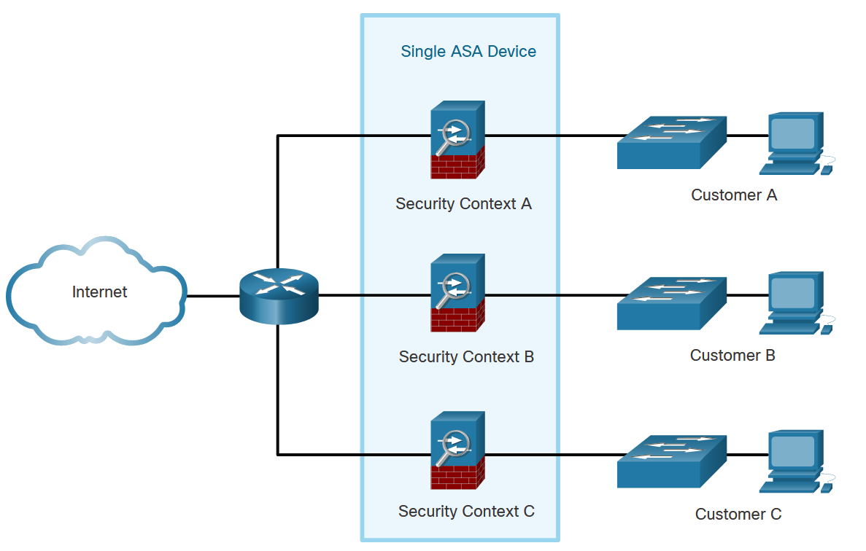
ASA Solutions
Advanced ASA Firewall Features
A single ASA can be partitioned into multiple virtual devices, as illustrated here. Each virtual device is called a security context. Each context is an independent device, with its own security policy, interfaces, and administrators. Multiple contexts are similar to having multiple standalone devices. Many features are supported in multiple context modes, including routing tables, firewall features, IPS, and management. Some features are not supported, including VPN and dynamic routing protocols.
Notes:
20: Introduction to the ASA 20.1: ASA Solutions 20.1.3: Advanced ASA Firewall Features

Slide 14
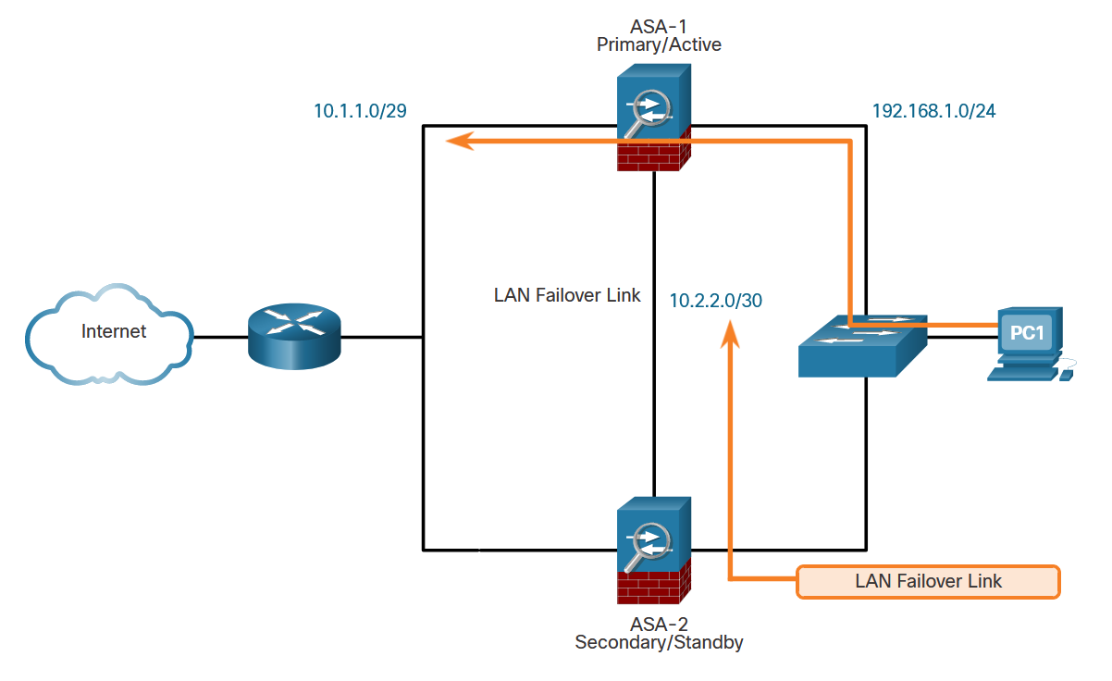
ASA Solutions
Advanced ASA Firewall Features (Cont.)
As shown here, two identical ASAs can be paired into an active / standby failover configuration to provide device redundancy. Both platforms must be identical in software, licensing, memory, and interfaces, including the Security Services Module (SSM). In the example, ASA-1 is the primary/active forwarding device and traffic leaving PC-1 takes the preferred path using ASA-1. ASA-1 and ASA-2 monitor each other using the LAN failover link. If ASA-1 fails, then ASA-2 would immediately assume the primary role and become active.
Notes:
20: Introduction to the ASA 20.1: ASA Solutions 20.1.3: Advanced ASA Firewall Features

Slide 15
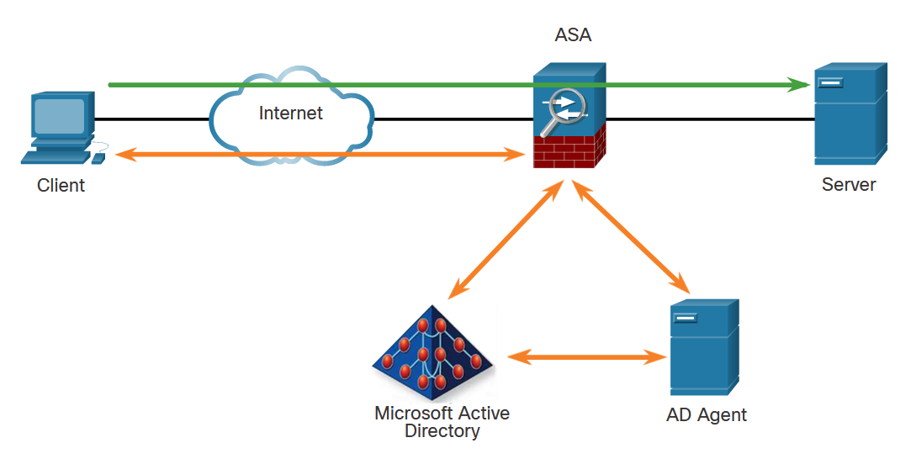
ASA Solutions
Advanced ASA Firewall Features (Cont.)
The ASA provides optional, granular access control based on an association of IP addresses to Windows Active Directory login information. For example, in the figure, when a client attempts to access the server resources, it must first be authenticated using the Microsoft Active Directory Identity-based firewall services. These services enhance the existing access control and security policy mechanisms by allowing users, or groups, to be specified in place of source IP addresses. Identity-based security policies can be interleaved without restriction between traditional IP address-based rules.
Notes:
20: Introduction to the ASA 20.1: ASA Solutions 20.1.3: Advanced ASA Firewall Features

Slide 16
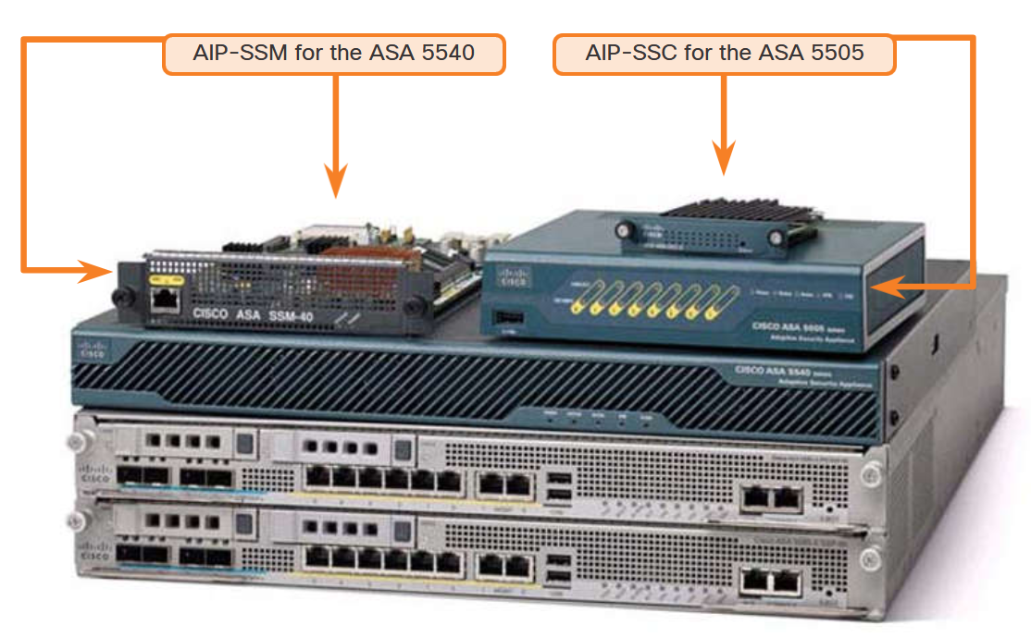
ASA Solutions
Advanced ASA Firewall Features (Cont.)
The ASA uses the Advanced Inspection and Prevention (AIP) modules. Antimalware capabilities can be deployed by integrating the Content Security and Control (CSC) module. The Cisco Advanced Inspection and Prevention Security Services Module (AIP-SSM) and Cisco Advanced Inspection and Prevention Security Services Card (AIP-SSC) deliver protection against tens of thousands of known exploits.
Notes:
20: Introduction to the ASA 20.1: ASA Solutions 20.1.3: Advanced ASA Firewall Features

Slide 17
ASA Solutions
Cisco Firepower Series
Cisco has introduced a new line of next-generation firewalls (NGFW) which combines their proven firewall technology with Sourcefire advanced threat and malware detection capabilities.
These NGFWs consolidate multiple security layers into a single platform, eliminating the cost of buying and managing multiple solutions. This integrated approach combines best-in-class security technology with multilayer protection that is integrated into a single device.
The Cisco ASA 5500-X with FirePOWER Services devices are part of the new Cisco NGFWs. Designed for small to medium branch offices, the ASA 5500-X with FirePOWER Services merges the ASA 5500 stateful firewall features with some of the following advanced threat and malware detection capabilities:
Next-generation IPS (NGIPS)
Advanced Malware Protection (AMP)
Application control and URL filtering
Notes:
20: Introduction to the ASA 20.1: ASA Solutions 20.1.4: Cisco Firepower Series

Slide 18
ASA Solutions
Video - Collect Firepower Threat Defense (FTD) Packet Captures with Firepower Management Center (FMC)
This video explains Firepower Threat Defense Packet Captures with Firepower Management Center.
Notes:
20: Introduction to the ASA 20.1: ASA Solutions 20.1.5: Video - Collect Firepower Threat Defense (FTD) Packet Captures with Firepower Management Center (FMC)

Slide 19
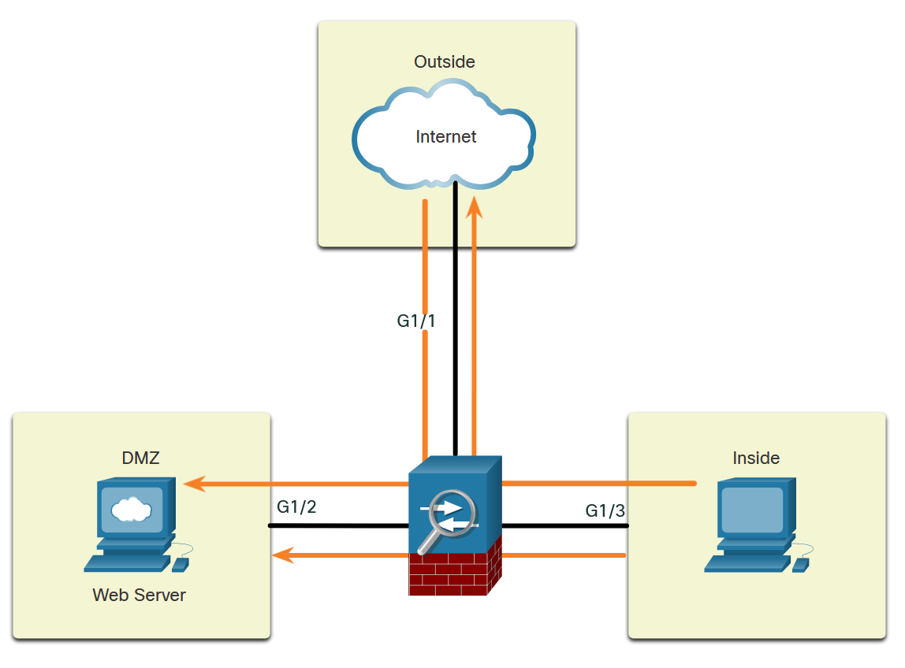
ASA Solutions
Review of Firewalls in Network Design
When discussing networks that are connected to a firewall, there are some general terms to consider:
Outside network - The network/zone that is outside the protection of the firewall.
Inside network - The network/zone that is protected and behind the firewall.
DMZ - The demilitarized zone that allows both inside and outside users access to protected network resources.
Firewalls protect inside networks from unauthorized access by users who are on an outside network. They also protect inside network users from each other. For example, by creating zones, an administrator can keep the network that is hosting the accounting servers separate from other networks in an organization.
The figure illustrates how these zones interact for permitted traffic:
Traffic originating from the inside network going to the outside network is permitted.
Traffic originating from the inside network going to the DMZ network is permitted.
Traffic originating from the outside network going to the DMZ network is selectively permitted.
Notes:
20: Introduction to the ASA 20.1: ASA Solutions 20.1.6: Review of Firewalls in Network Design

Slide 20
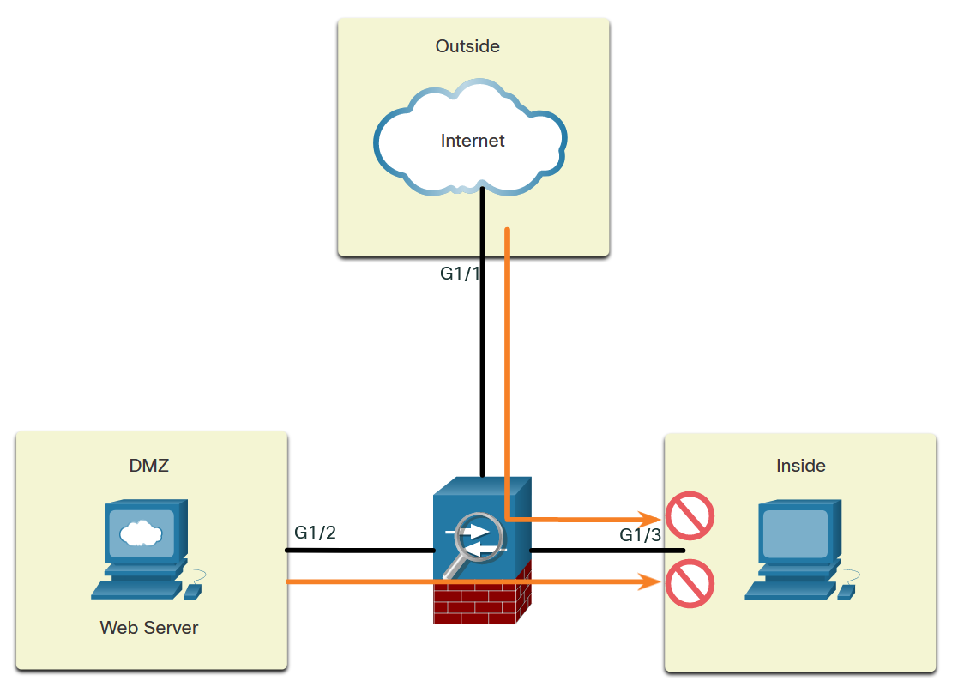
ASA Solutions
Review of Firewalls in Network Design (Cont.)
The figure illustrates how these zones interact for denied traffic:
Traffic originating from the outside network going to the inside network is denied.
Traffic originating from the DMZ network going to the inside network is denied.
Cisco ISRs can provide firewall features by using either the Zone-Based Policy Firewall (ZPF) or by using the older context-based access control (CBAC) feature.
Notes:
20: Introduction to the ASA 20.1: ASA Solutions 20.1.7: ASA Firewall Modes of Operation

Slide 21
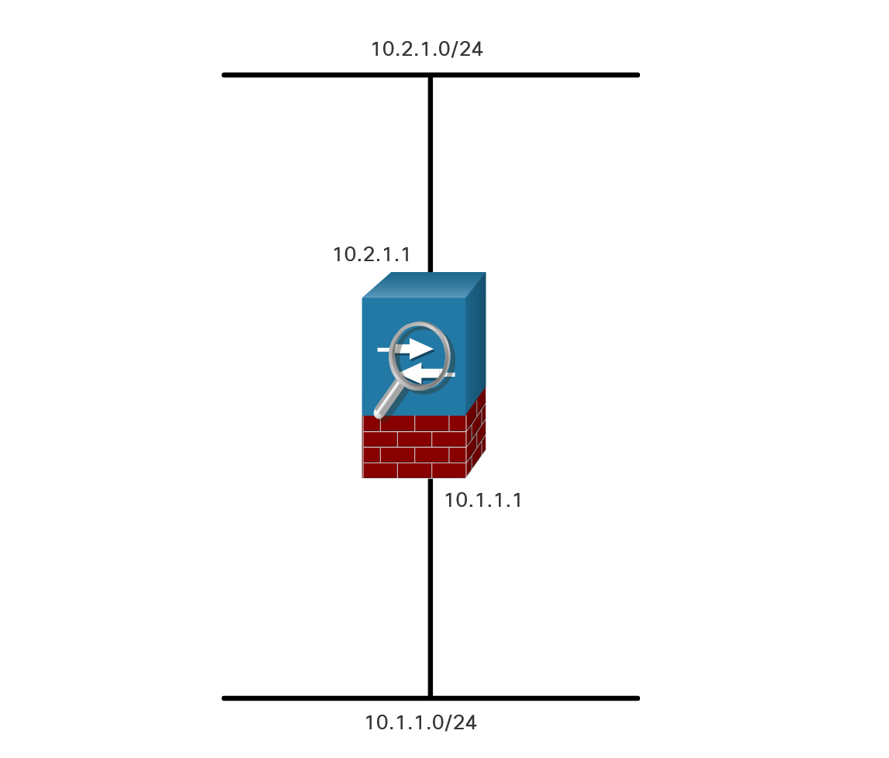
ASA Solutions
ASA Firewall Modes of Operation
Routed Mode
There are two firewall interface modes of operation available on ASA devices: routed mode and transparent mode.
In routed mode, two or more interfaces separate Layer 3 networks, i.e. domains.
In the figure, the ASA is considered to be a router hop in the network and can perform NAT between connected networks. Routed mode supports multiple interfaces. Each interface is on a different subnet and requires an IP address on that subnet. The ASA applies policies to flows as they transit the firewall.
Notes:
20: Introduction to the ASA 20.1: ASA Solutions 20.1.7: ASA Firewall Modes of Operation

Slide 22
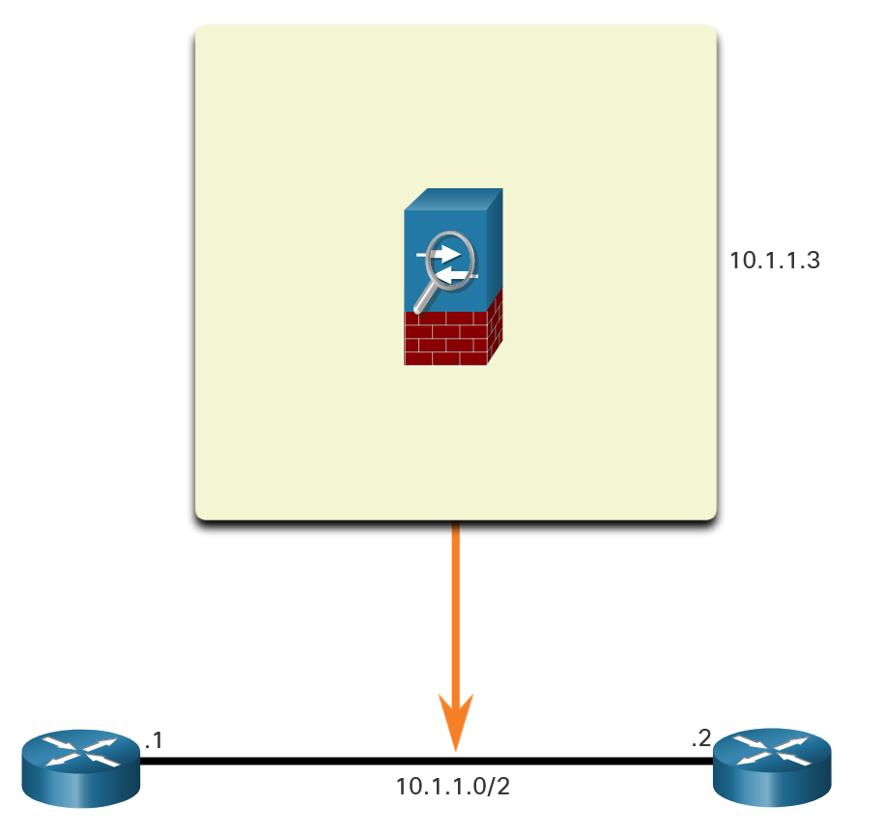
ASA Solutions
ASA Firewall Modes of Operation (Cont.)
Transparent Mode
An ASA in transparent mode is often referred to as a “bump in the wire,” or a “stealth firewall” because the ASA functions like a Layer 2 device and is not considered a router hop. In the figure below, the ASA is only assigned an IP address on the local network for management purposes. This mode is useful to simplify a network configuration, or when the existing IP addressing cannot be altered. However, the drawbacks include no support for dynamic routing protocols, VPNs, QoS, or DHCP Relay.
Notes:
20: Introduction to the ASA 20.1: ASA Solutions 20.1.7: ASA Firewall Modes of Operation

Slide 23
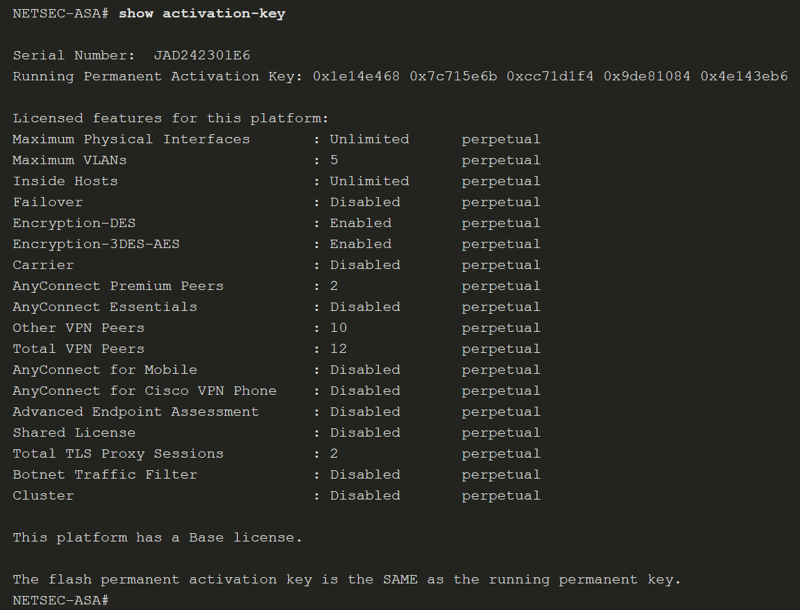
ASA Solutions
ASA Licensing Requirements
A license specifies the options that are enabled on a given ASA. Most ASA appliances come pre-installed with either a Base license or a Security Plus license.
To provide more features to the ASA, additional time-based or optional licenses can be purchased.
To verify the license information on an ASA device, use the show activation-key command, as shown below, or the show version command.
Notes:
20: Introduction to the ASA 20.1: ASA Solutions 20.1.8: ASA Licensing Requirements

Slide 24
20.2 The ASA 5506-X with FirePOWER Services
Notes:
20: Introduction to the ASA 20.2: The ASA 5506-X with FirePOWER Services

Slide 25
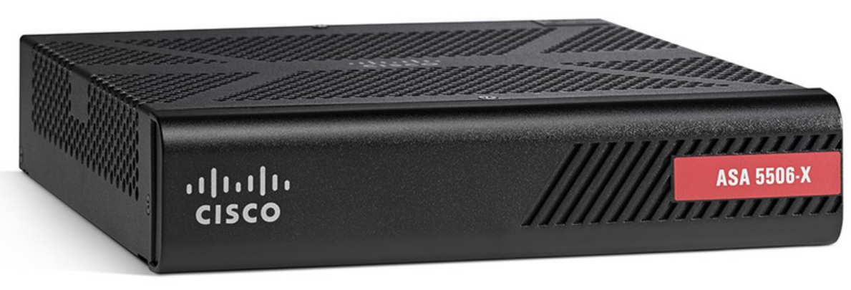
The ASA 5506-X with FirePOWER Services
Overview of ASA 5506-X
The Cisco ASA 5506-X delivers a high-performance firewall, SSL VPN, IPsec VPN, and rich networking services in a modular, plug-and-play appliance. The default DRAM memory is 4 GB and the default internal flash memory is 8 GB. In a failover configuration, the two units must be identical models with the same hardware configuration, the same number and types of interfaces, and the same amount of RAM. Failover is available with the Security Plus license.
The figure illustrates the front panel of the ASA 5506-X.
Notes:
20: Introduction to the ASA 20.2: The ASA 5506-X with FirePOWER Services 20.2.1: Overview of ASA 5506-X

Slide 26
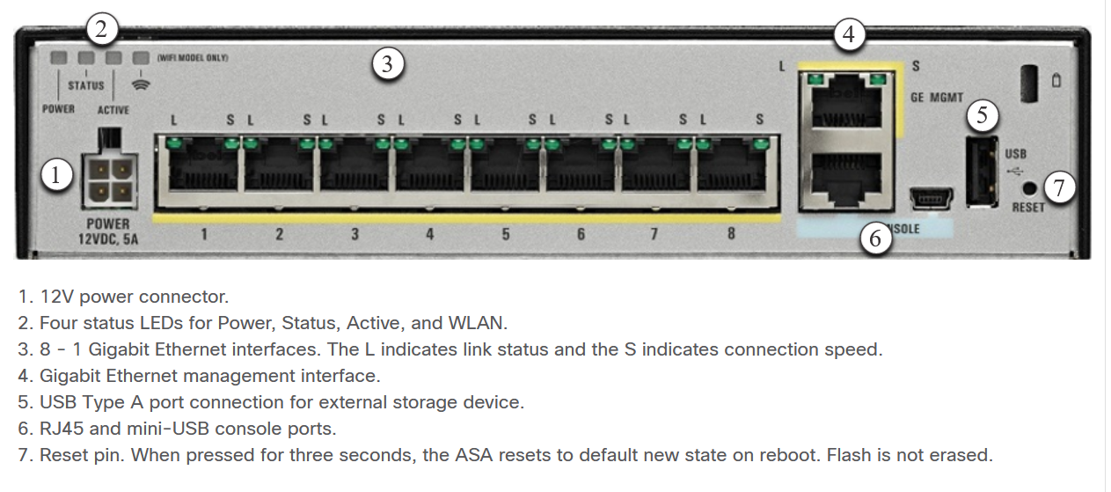
The ASA 5506-X with FirePOWER Services
Overview of ASA 5506-X
The figure illustrates the back panel of the Cisco ASA 5506-X.
Notes:
20: Introduction to the ASA 20.2: The ASA 5506-X with FirePOWER Services 20.2.1: Overview of ASA 5506-X

Slide 27
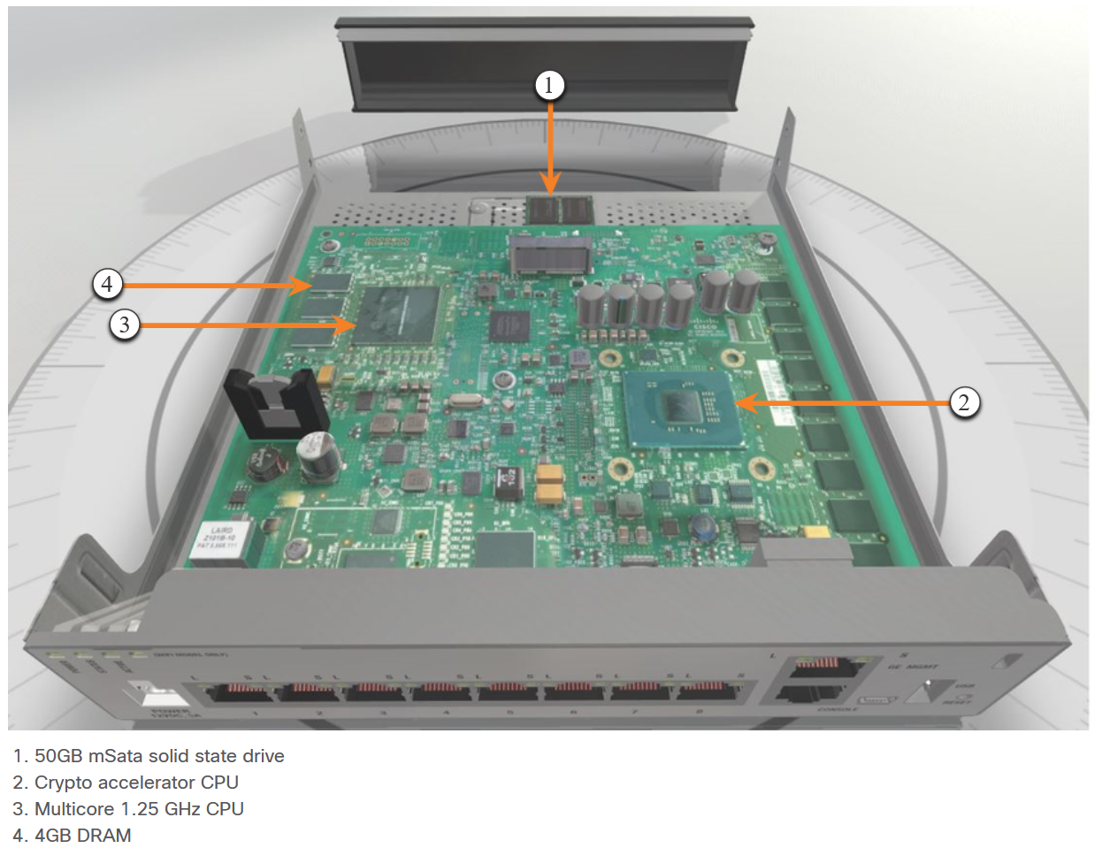
The ASA 5506-X with FirePOWER Services
Overview of ASA 5506-X (Cont.)
The figure shows the inside components of the Cisco ASA 5506-X.
Unlike the ASA 5505, the ASA 5506-X does not use switchports. All interfaces are routed and require IP addresses.
Notes:
20: Introduction to the ASA 20.2: The ASA 5506-X with FirePOWER Services 20.2.1: Overview of ASA 5506-X

Slide 28
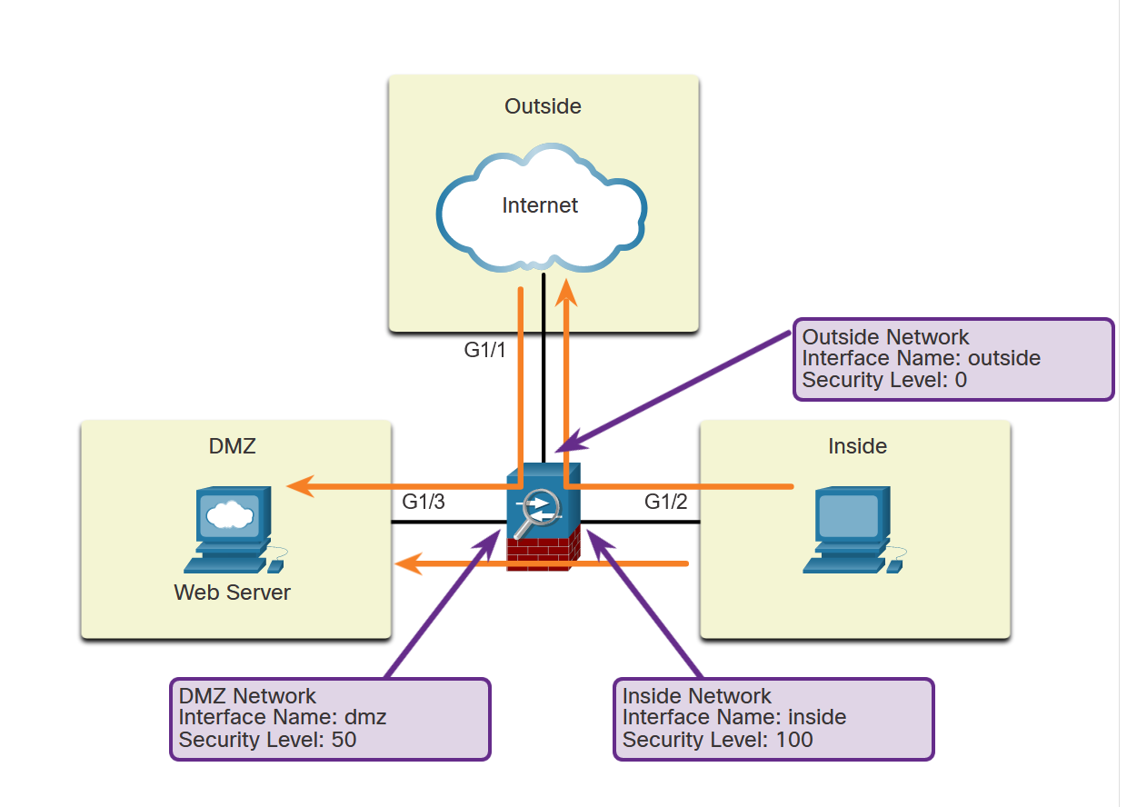
The ASA 5506-X with FirePOWER Services
ASA Security Levels
Security levels define the level of trustworthiness of an interface. Each operational interface must have a name and a security level from 0 (lowest) to 100 (highest) assigned.
As shown in the figure, level 100 should be assigned to the most secure network, such as the inside network. Level 0 can be assigned to the outside network, which is connected to the internet. DMZs and other networks can be assigned a security level between 0 and 100
Notes:
20: Introduction to the ASA 20.2: The ASA 5506-X with FirePOWER Services 20.2.2: ASA Security Levels

Slide 29
The ASA 5506-X with FirePOWER Services
ASA Security Levels (Cont.)
Security levels help to control many aspects of network traffic as shown in the table below.
Aspect | Effect
Network Access | By default, there is an implicit permit from a higher security interface to a lower security interface (outbound). Hosts on the higher security interface can access hosts on a lower security interface. Multiple interfaces can be assigned the same security level. If communication is enabled for interfaces with the same security level, there is an implicit permit for traffic between the interfaces.
Inspection Engines | Some application inspection engines are dependent on the security level. When interfaces have the same security level, the ASA inspects traffic in either direction.
Application Filtering | HTTPS and FTP filtering applies only for outbound connections that are from a higher level to a lower level. If communication is enabled for interfaces with the same security level, traffic can be filtered in either direction.
Notes:
20: Introduction to the ASA 20.2: The ASA 5506-X with FirePOWER Services 20.2.2: ASA Security Levels

Slide 30
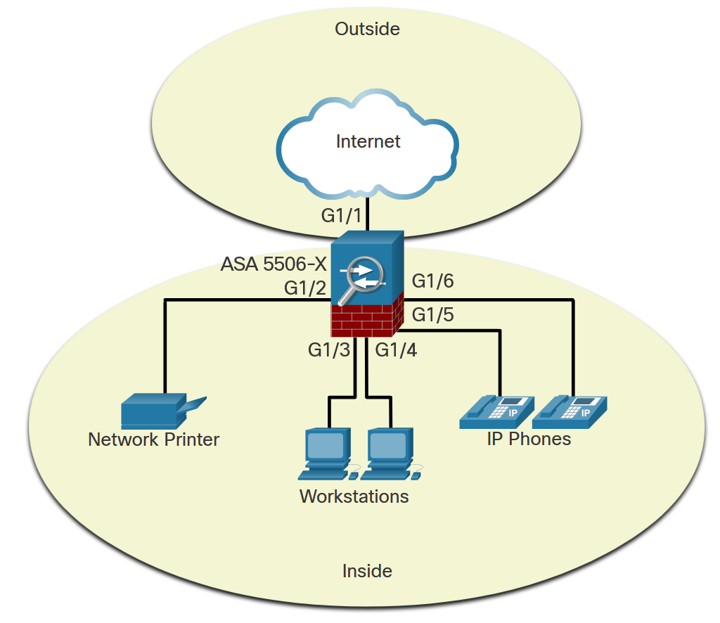
The ASA 5506-X with FirePOWER Services
ASA 5506-X Deployment Scenarios
Small Branch
The ASA 5506-X is commonly used as an edge security device. It connects a small business to an ISP device, such as a DSL or cable modem, for access to the internet. It can be deployed to interconnect and protect several workstations, network printers, and IP phones.
In a small branch, a common deployment would include an inside network (VLAN 1) with security level 100 and an outside network (VLAN 2) with security level 0, as shown in the figure.
Notes:
20: Introduction to the ASA 20.2: The ASA 5506-X with FirePOWER Services 20.2.3: ASA 5506-X Deployment Scenarios

Slide 31
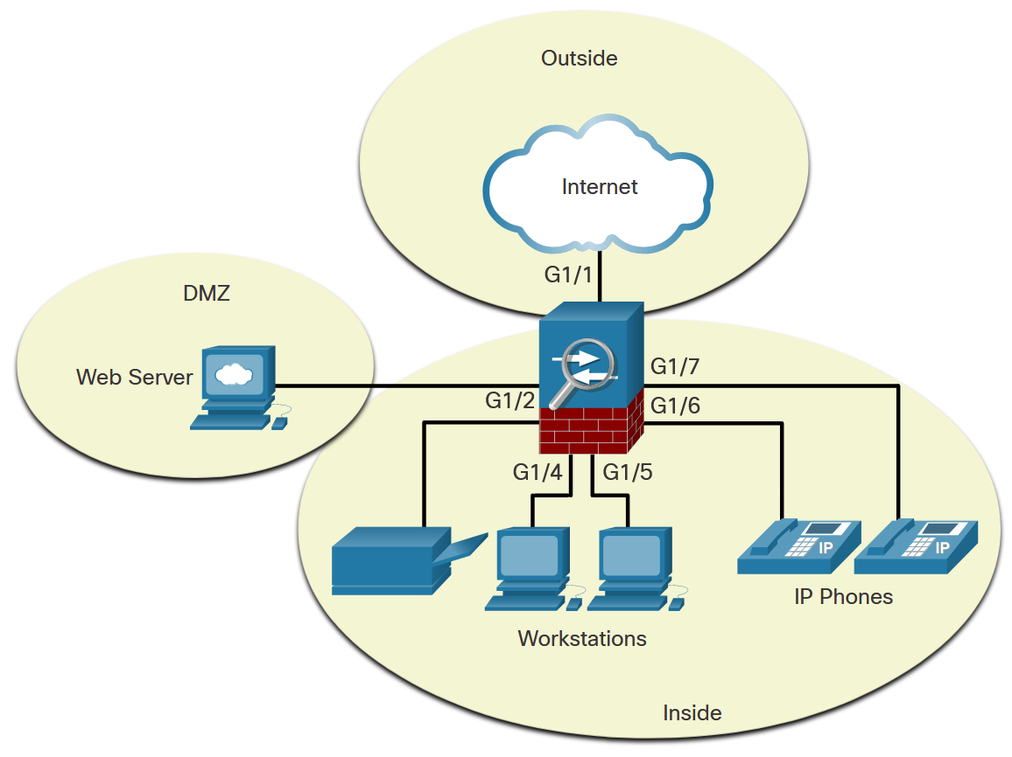
The ASA 5506-X with FirePOWER Services
ASA 5506-X Deployment Scenarios (Cont.)
Small Business
In the small business, shown here, the ASA 5505 can be deployed with two different protected network segments. One segment is the inside network (VLAN 1), which connects workstations and IP phones. The other segment is the DMZ (VLAN 3), which connects a company web server. The outside interface (VLAN 2) is used to connect to the internet.
Notes:
20: Introduction to the ASA 20.2: The ASA 5506-X with FirePOWER Services 20.2.3: ASA 5506-X Deployment Scenarios

Slide 32
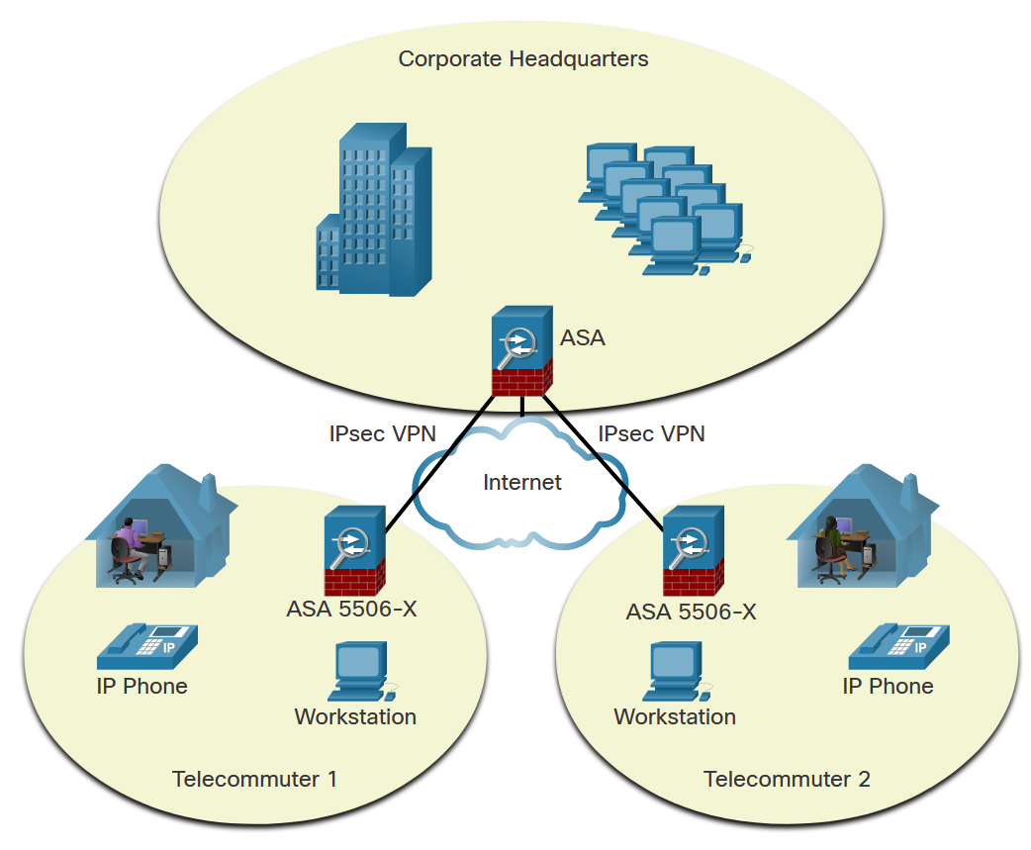
The ASA 5506-X with FirePOWER Services
ASA 5506-X Deployment Scenarios (Cont.)
Enterprise
In an enterprise deployment, as shown here, the ASA 5505 can be used by telecommuters and home users to connect to a centralized location using a VPN.
Notes:
20: Introduction to the ASA 20.2: The ASA 5506-X with FirePOWER Services 20.2.3: ASA 5506-X Deployment Scenarios

Slide 33
20.3 Introduction to the ASA Summary
Notes:
20: Introduction to the ASA 20.3: Introduction to the ASA Summary

Slide 34
Introduction to the ASA Summary
What Did I Learn in this Module?
The choice of ASA model depends on an organization’s requirements, such as maximum throughput, maximum connections per second, and budget.
When discussing networks connected to a firewall, terms to consider include outside network, inside network, and the DMZ.
There are two firewall interface modes of operation available on ASA devices: routed mode and transparent mode.
Advanced ASA firewall features include ASA virtualization, high availability with failover, identity firewall, and threat control and containment services.
Most ASA appliances come pre-installed with either a Base license or a Security Plus license.
The Cisco ASA 5506-X delivers a high-performance firewall, SSL VPN, IPsec VPN, and rich networking services in a plug-and-play appliance.
The security level numbers range from 0 (untrustworthy) to 100 (very trustworthy).
The ASA 5506-X is commonly used as an edge security device. It connects a small business to an ISP device, such as a DSL or cable modem, for access to the internet.
Notes:
20: Introduction to the ASA 20.3: Introduction to the ASA Summary 20.3.1: What Did I Learn in this Module?
20.3.2: Module Quiz

Slide 35
Introduction to the ASA Summary
New Terms and Commands
Security Services Module (SSM) Content Security and Control (CSC) module Advanced Inspection and Prevention Security Services Module (AIP-SSM) Advanced Inspection and Prevention Security Services Card (AIP-SSC) Next-generation IPS (NGIPS) Outside network Inside network context-based access control (CBAC) routed mode transparent mode show activation-key inspection engines application filtering
Notes:
20 – Introduction to the ASA
New Terms and Commands

